Slide 1



1

Slide 2
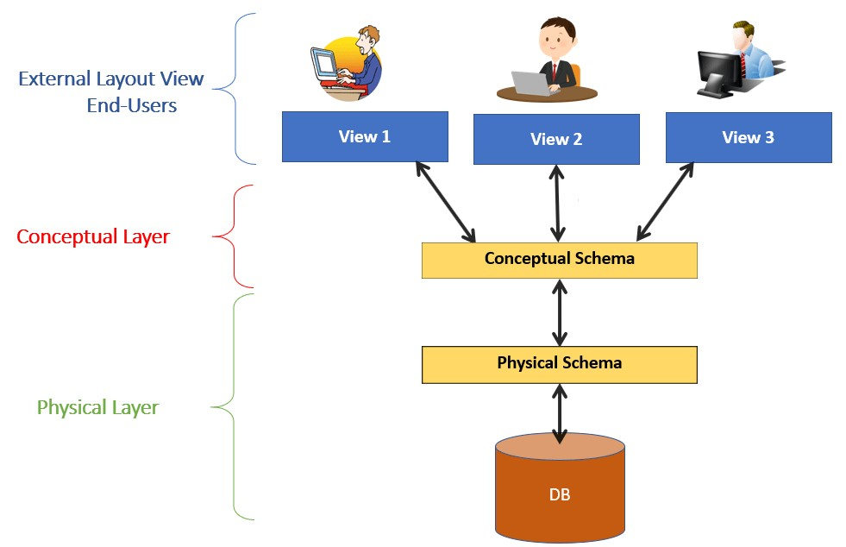
View of Data
7

Slide 3
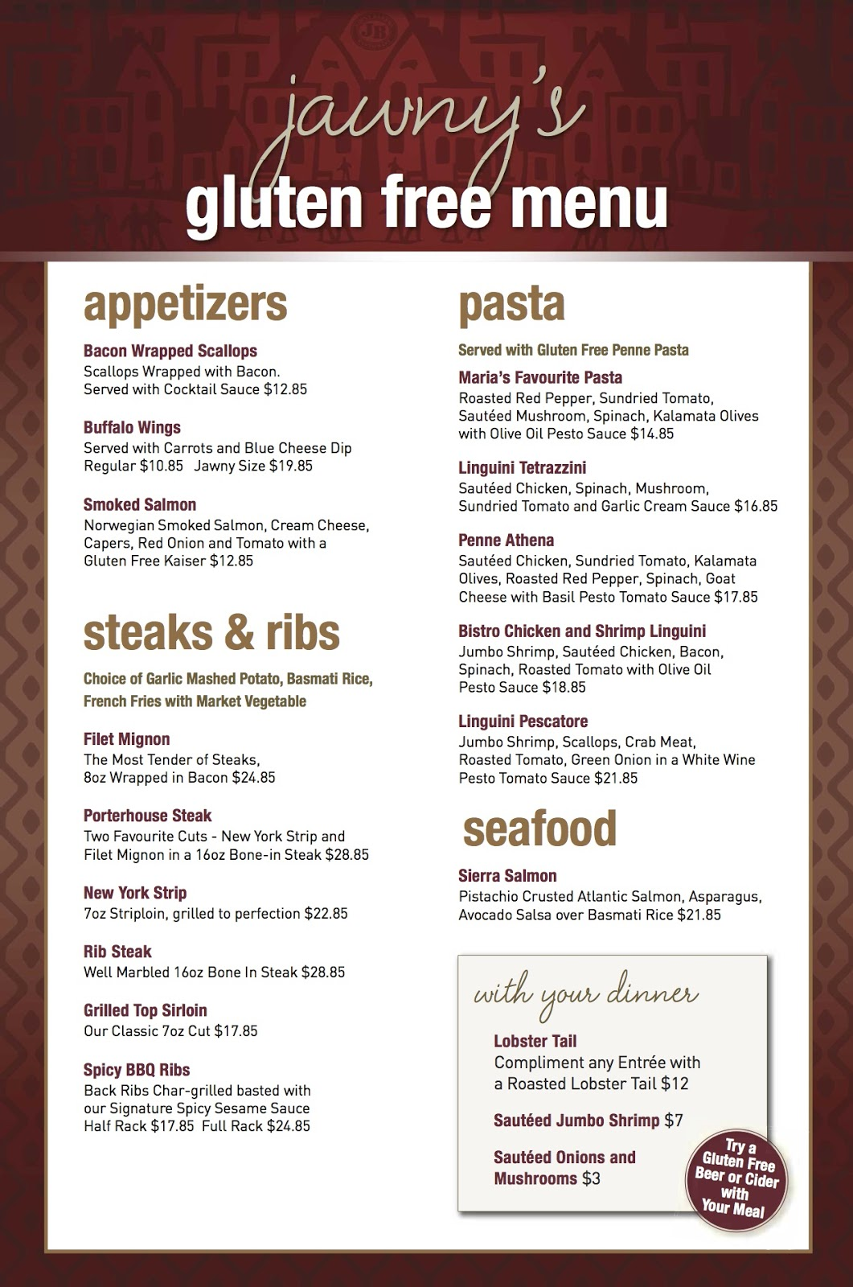

DBMS
This Photo by Unknown Author is licensed under CC BY-SA

Slide 4
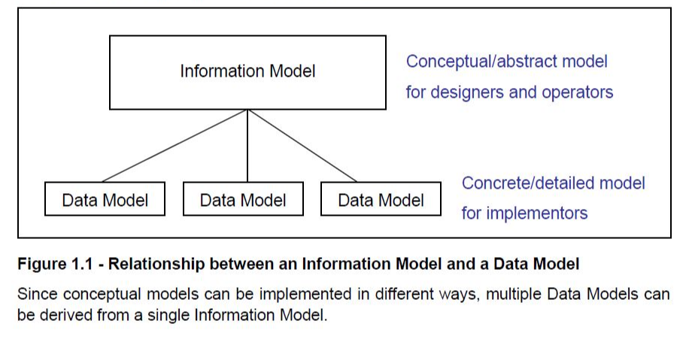

Slide 5
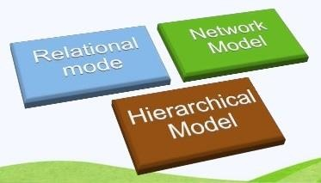
Data Models
13
A Database model defines the logical design and structure of a database and defines how data will be stored, accessed and updated in a database management system. While the Relational Model is the most widely used database model, there are other models too:
Hierarchical Model
Network Model
Entity-relationship Model
Relational Model

Slide 6
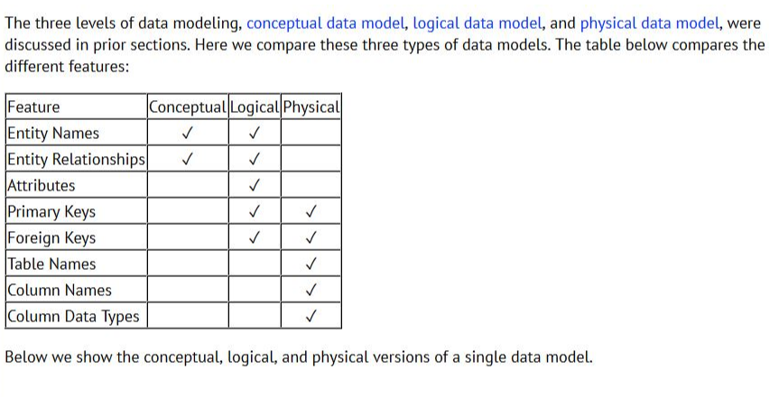

Slide 7
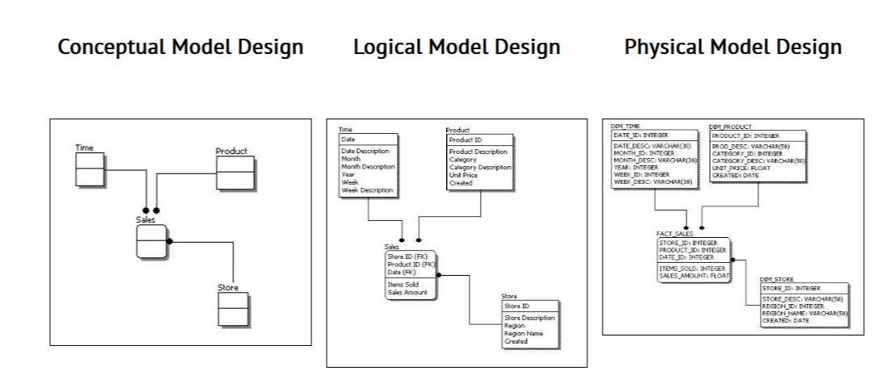

Slide 8
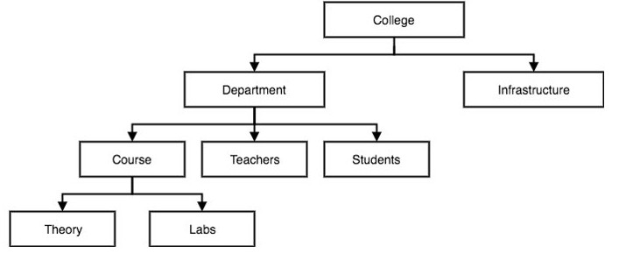
Hierarchical Model
14
 This database model organizes data into a tree-like-structure, with a single root, to which all the other data is linked. The hierarchy starts from the Root data, and expands like a tree, adding child nodes to the parent nodes.
Hierarchical Model

Slide 9
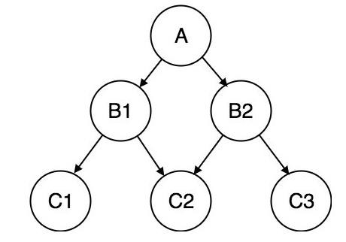
Network Model
15
This is an extension of the Hierarchical model. In this model data is organized more like a graph, and are allowed to have more than one parent node.
In this database model data is more related as more relationships are established in this database model.
Also, as the data is more related, hence accessing the data is also easier and fast. This database model was used to map many-to-many data relationships.

Slide 10
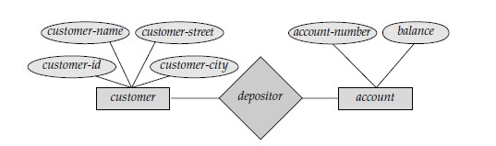
Entity-relationship Model
16
In this database model, relationships are created by dividing object of
interest into entity and its characteristics into attributes.
Different entities are related using relationships.
E-R Models are defined to represent the relationships into pictorial form to
make it easier for different stakeholders to understand.
A Sample E-R diagram

Slide 11
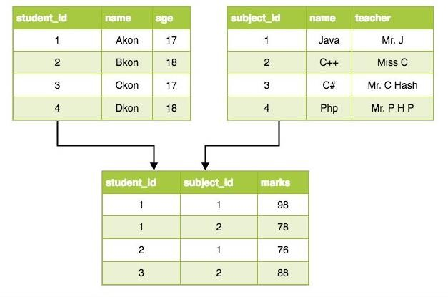
Relational Model
17
 In this model, data is organized in two-dimensional
relationship is maintained by storing a common field.
tables and the
This model was introduced by E.F Codd in 1970, and since then it has been the most widely used database model, in fact, we can say the only database model used around the world.
The basic structure of data in the relational model is tables. All the information related to a particular type is stored in rows of that table.
Relational Model

Slide 12
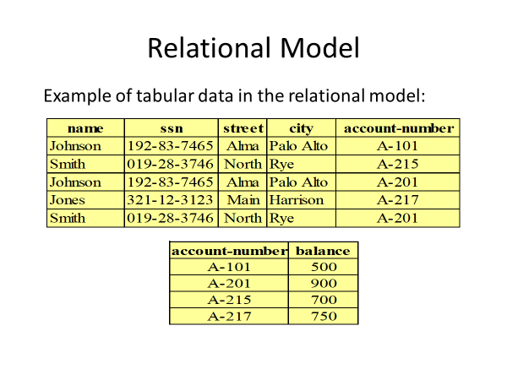

Slide 13
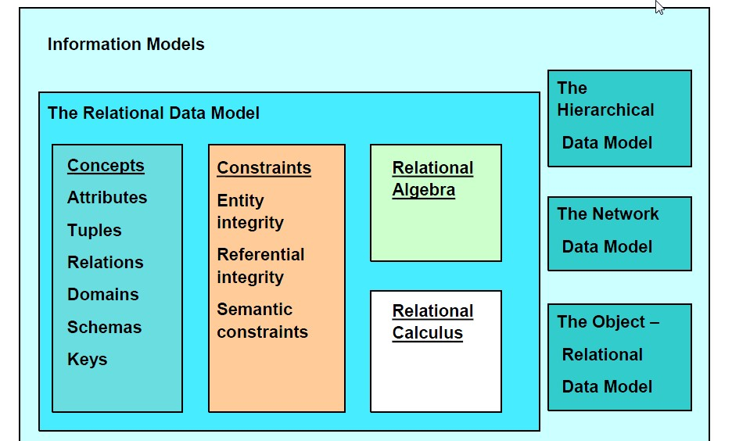

Slide 14
